Slide 1

Real-Time Object Detection in Aerial Surveillance Using YOLOv8, YOLOv10 & YOLOv11

Slide 2
Introduction
1. What is Object Detection?
4. Dataset Used — VisDrone2019
This dataset contains:
  Drone images taken from high altitudes
  Many tiny objects
  Occlusions (objects blocking each other)
  Crowded scenes (many objects close together)
These challenges make it a perfect dataset to test YOLO models.
Object detection means:
  Finding what objects are present in an image
  Finding where they are located using bounding boxes
This is why it’s called “detection + localization.
2. Why YOLO Models for Object Detection?
YOLO (“You Only Look Once”) is preferred because:
  It is accurate
  It works well in real-time applications like surveillance, drones, autonomous cars
So YOLO is the best choice for drone-based vision tasks.
3. Aim of This Project
  Your project focuses on comparing:
  YOLOv8
  YOLOv10
  YOLOv11
  All trained on the same dataset, using same settings, so the comparison is fair.

Slide 3
Challenges
Drone images create three big challenges:
1.Tiny Objects
  Objects like people and cars appear extremely small because the drone is far away.
2.Occlusion
  Objects overlap and hide each other — like people standing close or vehicles in traffic.
3.High-Density Scenes
  A single image may contain dozens of objects, making detection more difficult.
Traditional detectors like Faster-RCNN or older YOLO versions often struggle with these challenges.
Motivation
Why are you doing this project?
1.To evaluate modern YOLO versions (v8, v10, v11) under the same conditions
So we know which one truly performs better.
2.To find the best YOLO model for drone/UAV detection
Since drones are used in:
  Security
  Traffic monitoring
  Disaster management
  Smart cities Accurate detection becomes very important.

Slide 4

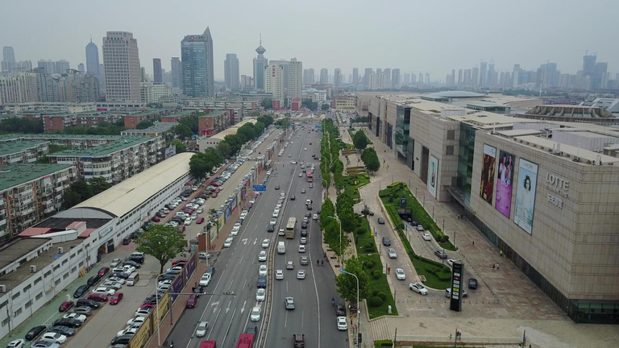
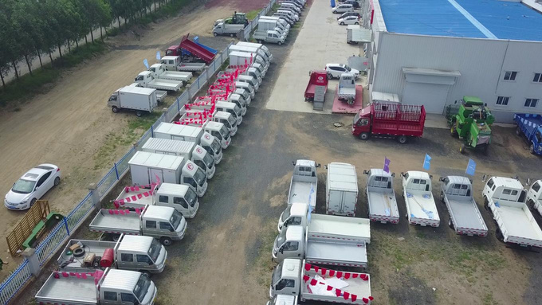
DATASET: VISDRONE
VisDrone2019 Dataset Overview
  Contains 10,209 static images and 2.6 million annotated bounding boxes.
  Includes 10 object categories: pedestrian, people, bicycle, car, van, truck, tricycle, awning-tricycle, bus, motor.
  Images captured from drones across 14 different cities in varying weather and lighting conditions.
Real-world challenges:
  Extremely small object sizes
  High-density traffic scenes
  Frequent occlusions
  Complex backgrounds

Slide 5
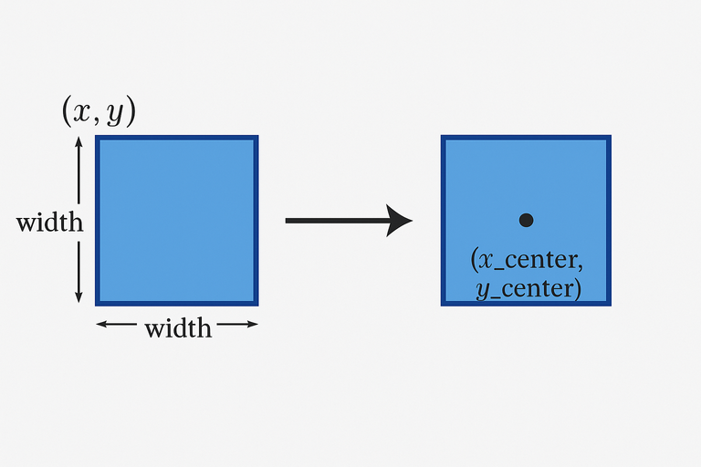
DATASET ANNOTATION & CONVERSION
VisDrone Annotation Format:
Each object annotation is provided in the format:
x, y, width, height, score, class, truncation, occlusion
YOLO Label Format Required:
YOLO requires labels in this format:
class x_center y_center width height
(all values normalized between 0 and 1)
Conversion Process:
  Your Convert top-left coordinates (x, y) to center coordinates.
  Normalize width and height relative to image size.
  Adjust class IDs to start from 0 (YOLO requirement).
  Skip invalid or zero-area bounding boxes.
  Save labels in YOLO-compatible .txt format for each image.

Slide 6
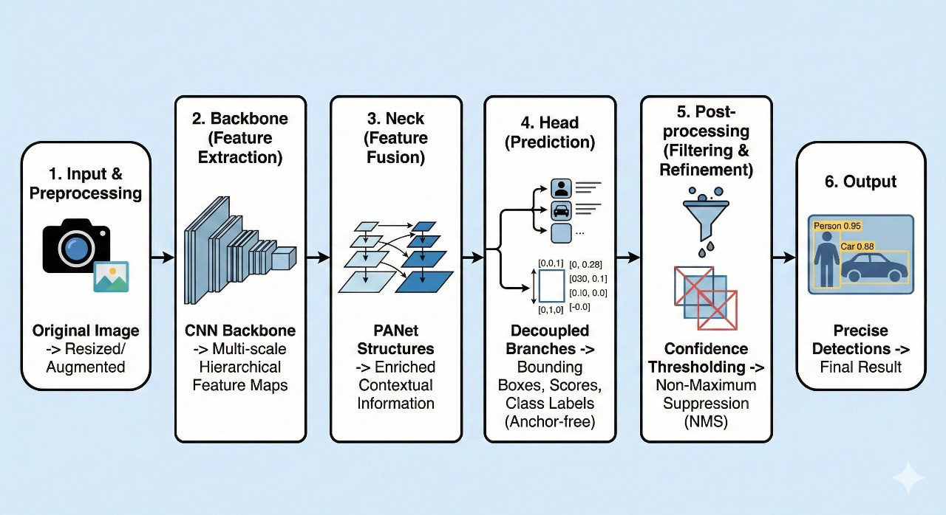
YOLOv8
YOLOv8 takes an input image, preprocesses it, and sends it through three main modules:
  Backbone to extract features,
  Neck to fuse multi-scale features, and
  Head to predict bounding boxes, class scores, and object confidence.
It uses an anchor-free detection approach and decoupled heads for better accuracy.
After predictions, confidence filtering and Non-Maximum Suppression (NMS) remove weak and duplicate boxes.
The final output is a set of clean bounding boxes with class labels and confidence scores, making YOLOv8 fast and suitable for real-time detection.

Slide 7
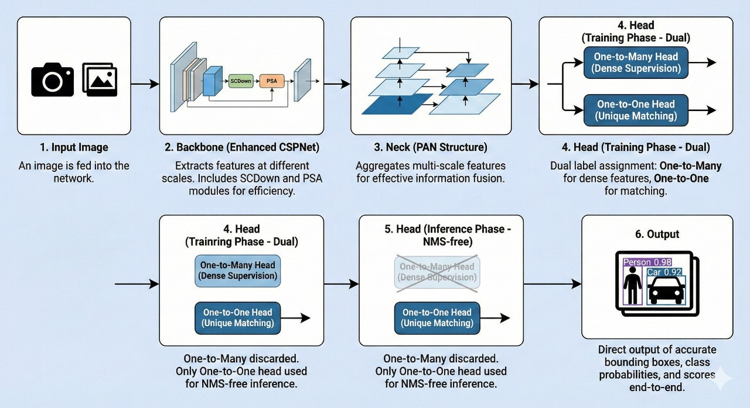
YOLOv10
YOLOv10 processes an input image through three main stages:
  Backbone (enhanced CSPNet) extracts multi-scale features using SCDown and PSA for better efficiency.
  Neck (PAN) fuses these features to strengthen multi-level information.
  Head uses a dual strategy during training:
One-to-Many head for dense supervision,
One-to-One head for precise matching and NMS-free prediction.
During inference, only the one-to-one head is used, allowing YOLOv10 to produce final bounding boxes without NMS, reducing latency and speeding up detection.
The output is clean, accurate bounding boxes with class labels and confidence scores in an end-to-end manner.

Slide 8
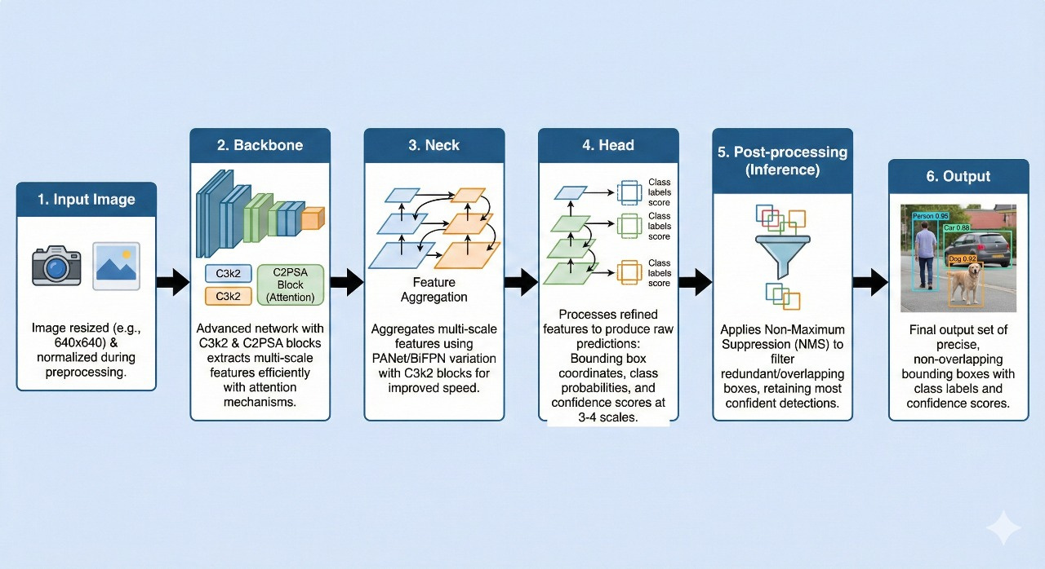
YOLOV11
YOLOv11 takes an input image, preprocesses it, and passes it through three main stages:
  Backbone to extract rich multi-scale features using improved blocks like C3k2/C2PSA,
  Neck to fuse and refine these features efficiently, and
  Head to predict bounding boxes, class probabilities, and confidence scores across multiple scales.
It improves speed and accuracy with lightweight feature blocks and enhanced feature fusion.
After prediction, confidence filtering and Non-Maximum Suppression (NMS) remove low-quality and duplicate boxes.
The final output is a set of accurate, non-overlapping bounding boxes with class labels and confidence scores, making YOLOv11 highly efficient for real-time object detection.

Slide 9
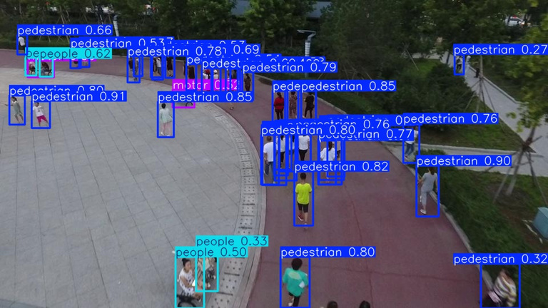
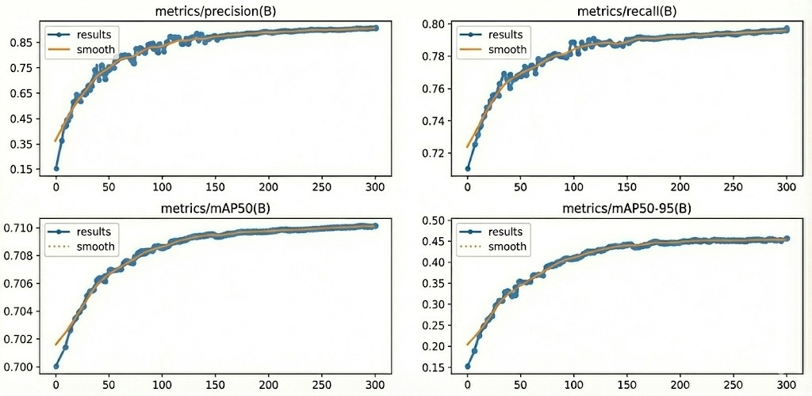
RESULTS
YOLOV8
Performance Metrics:
  mAP@0.5: 0.7052
  mAP@0.5:0.95: 0.45002
  Precision: 0.81065
  Recall: 0.75021
Observations:
  Performs well on medium and large objects.
  Struggles with small and heavily occluded objects due to simpler backbone.
Stable baseline for comparison.

Slide 10
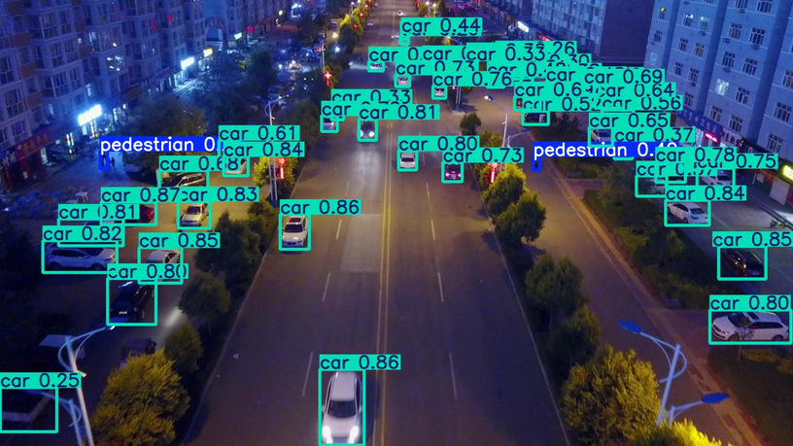
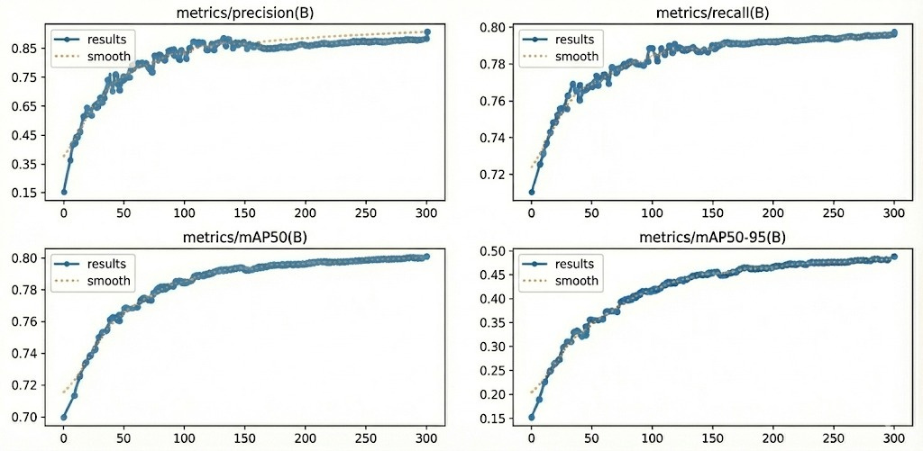
YOLOV10
Performance Metrics
  mAP@0.5: 0.78201
  mAP@0.5:0.95: 0.48102
  Precision: 0.84002
  Recall: 0.78201
Observations
  Improved accuracy over YOLOv8 due to better feature extraction.
  NMS-free inference improves speed and consistency.
  Better localization and stability.

Slide 11
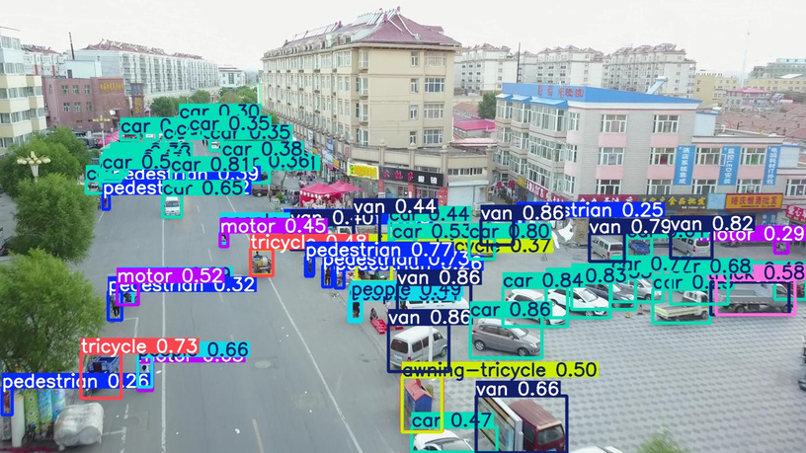
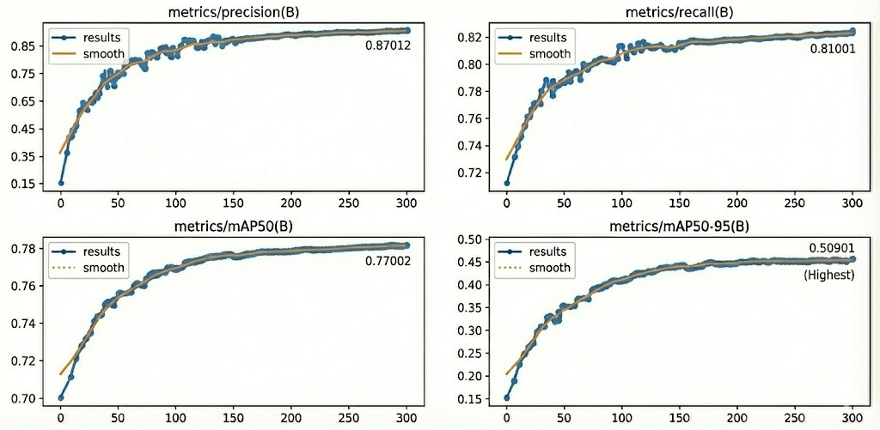
YOLOV11
Performance Metrics
  mAP@0.5: 0.77002
  mAP@0.5:0.95: 0.50901 (Highest)
  Precision: 0.87012
  Recall: 0.81001
Observations
  Best small-object detection among all models.
  Superior multi-scale feature fusion results in higher overall accuracy.
  Most robust in complex drone imagery scenarios.

Slide 12
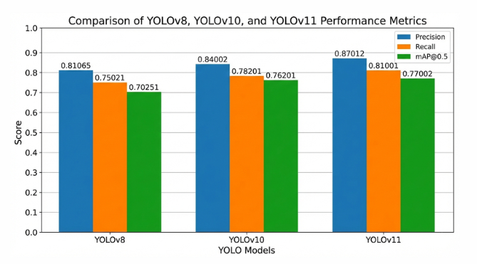
Comparison of YOLOV8, YOLOV10 and YOLOV11 Performance mertrics

Slide 13
Conclusion
  YOLOv11 provides the highest detection accuracy, especially for small and distant objects in aerial imagery.
  YOLOv10 offers the best balance between speed and accuracy, making it suitable for real-time UAV deployment.
  YOLOv8 performs well as a baseline model, but struggles under complex conditions like dense scenes and heavy occlusion.
  The VisDrone dataset remains challenging due to tiny objects, high occlusion, and variable lighting.
  Modern YOLO architectures demonstrate significant advancements in feature extraction, localization, and overall detection robustness.

Slide 14
THANK YOU

